Slide 1


Slide 2






Agenda
What it is
Prices
Who we are
Website
Conclusion

Slide 3

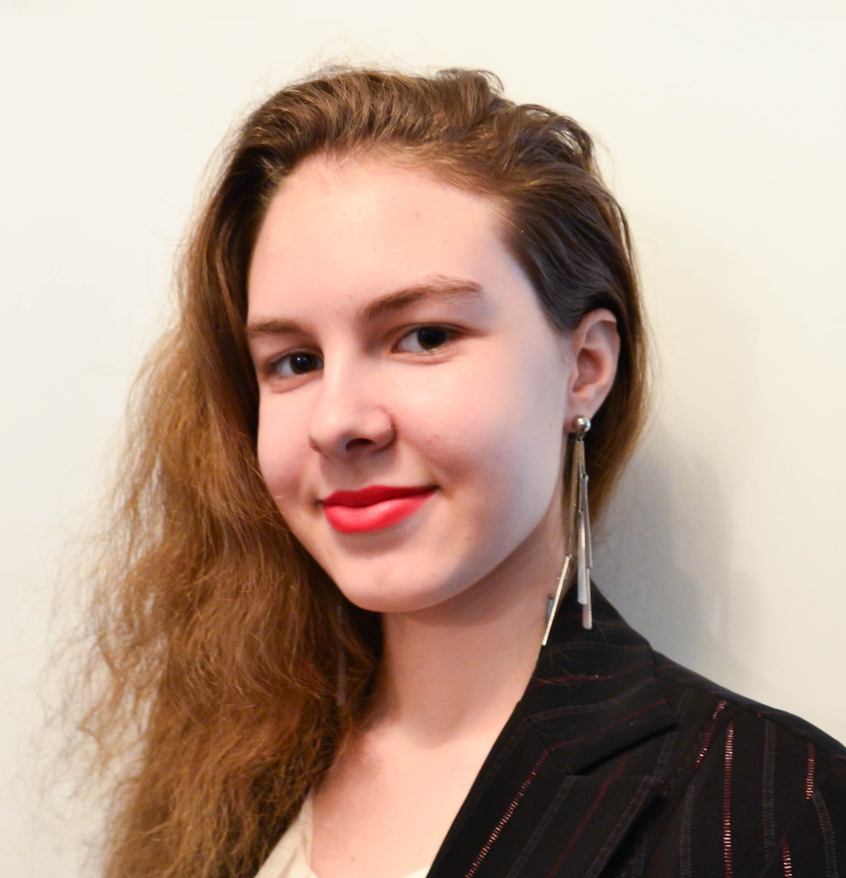
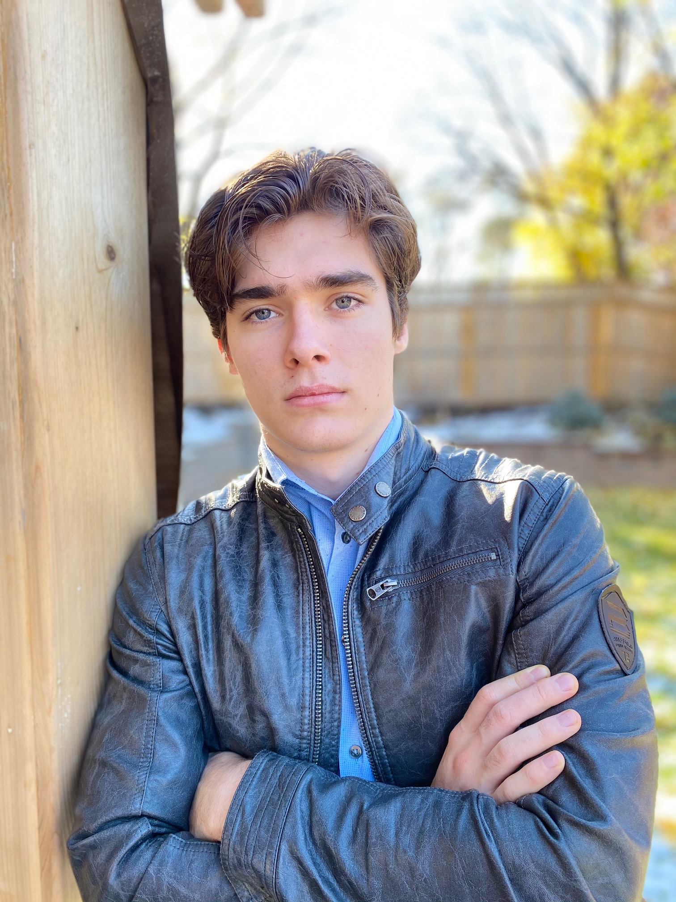

Svetlana Esina
Design specialist
Meet The Team
Daniel Andreev
Role
Jacob Pilon
Role

Slide 4


Jayden Bergevin
Design specialist
Meet The Team
Jean-Gabriel de Montigny
Human Resources Director
Maryan Khalil
Financial Director

Slide 5
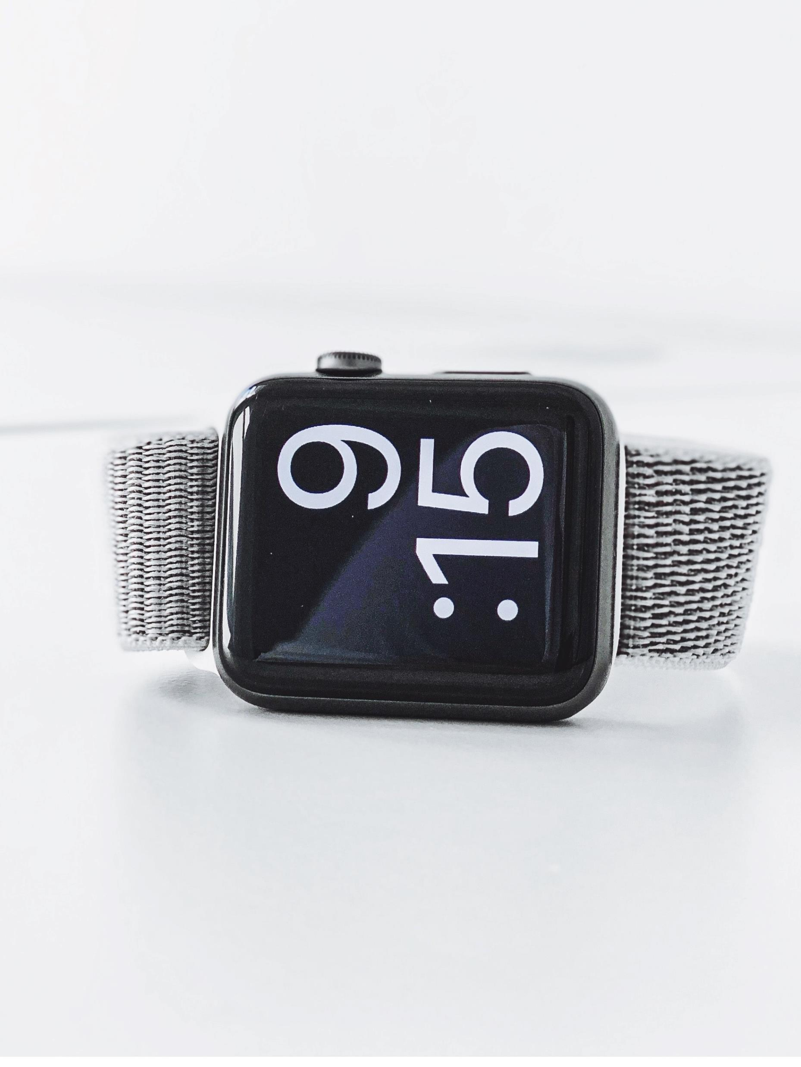
K.E.Y.S. Base
Price : $ 749
Features:
- Time keeping
- 5 liters of storage
- Digital password and interface
- 1 year warranty

Slide 6
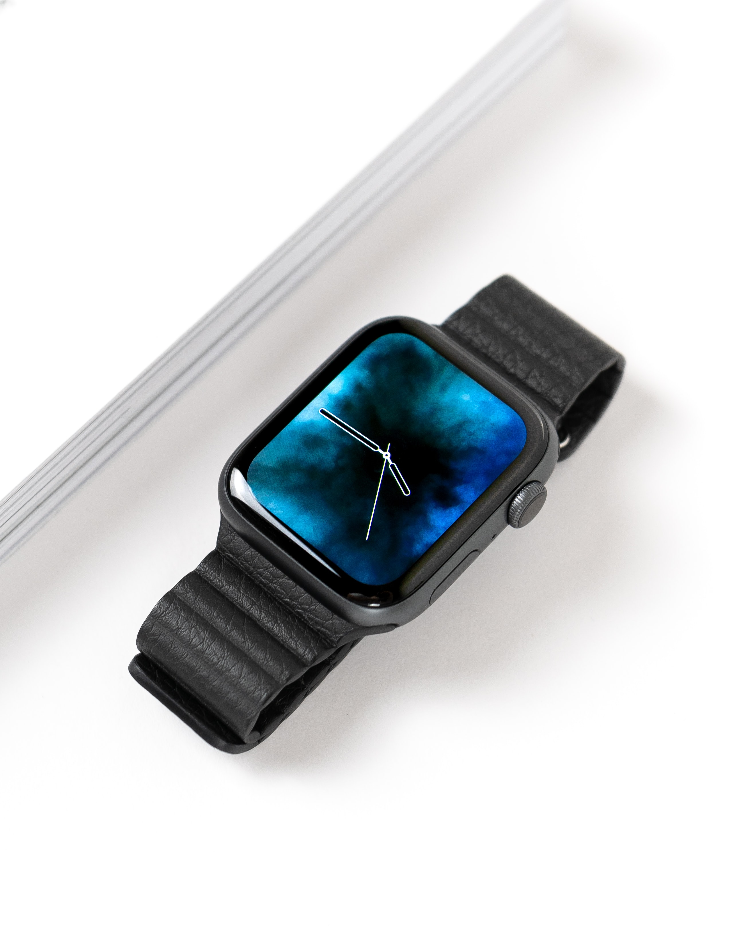
K.E.Y.S. Upgraded
Price : $ 999
Features :
- Time keeping
- 10 liters storages
- Face recognition
- Holographic interface
- 2 years warranty

Slide 7
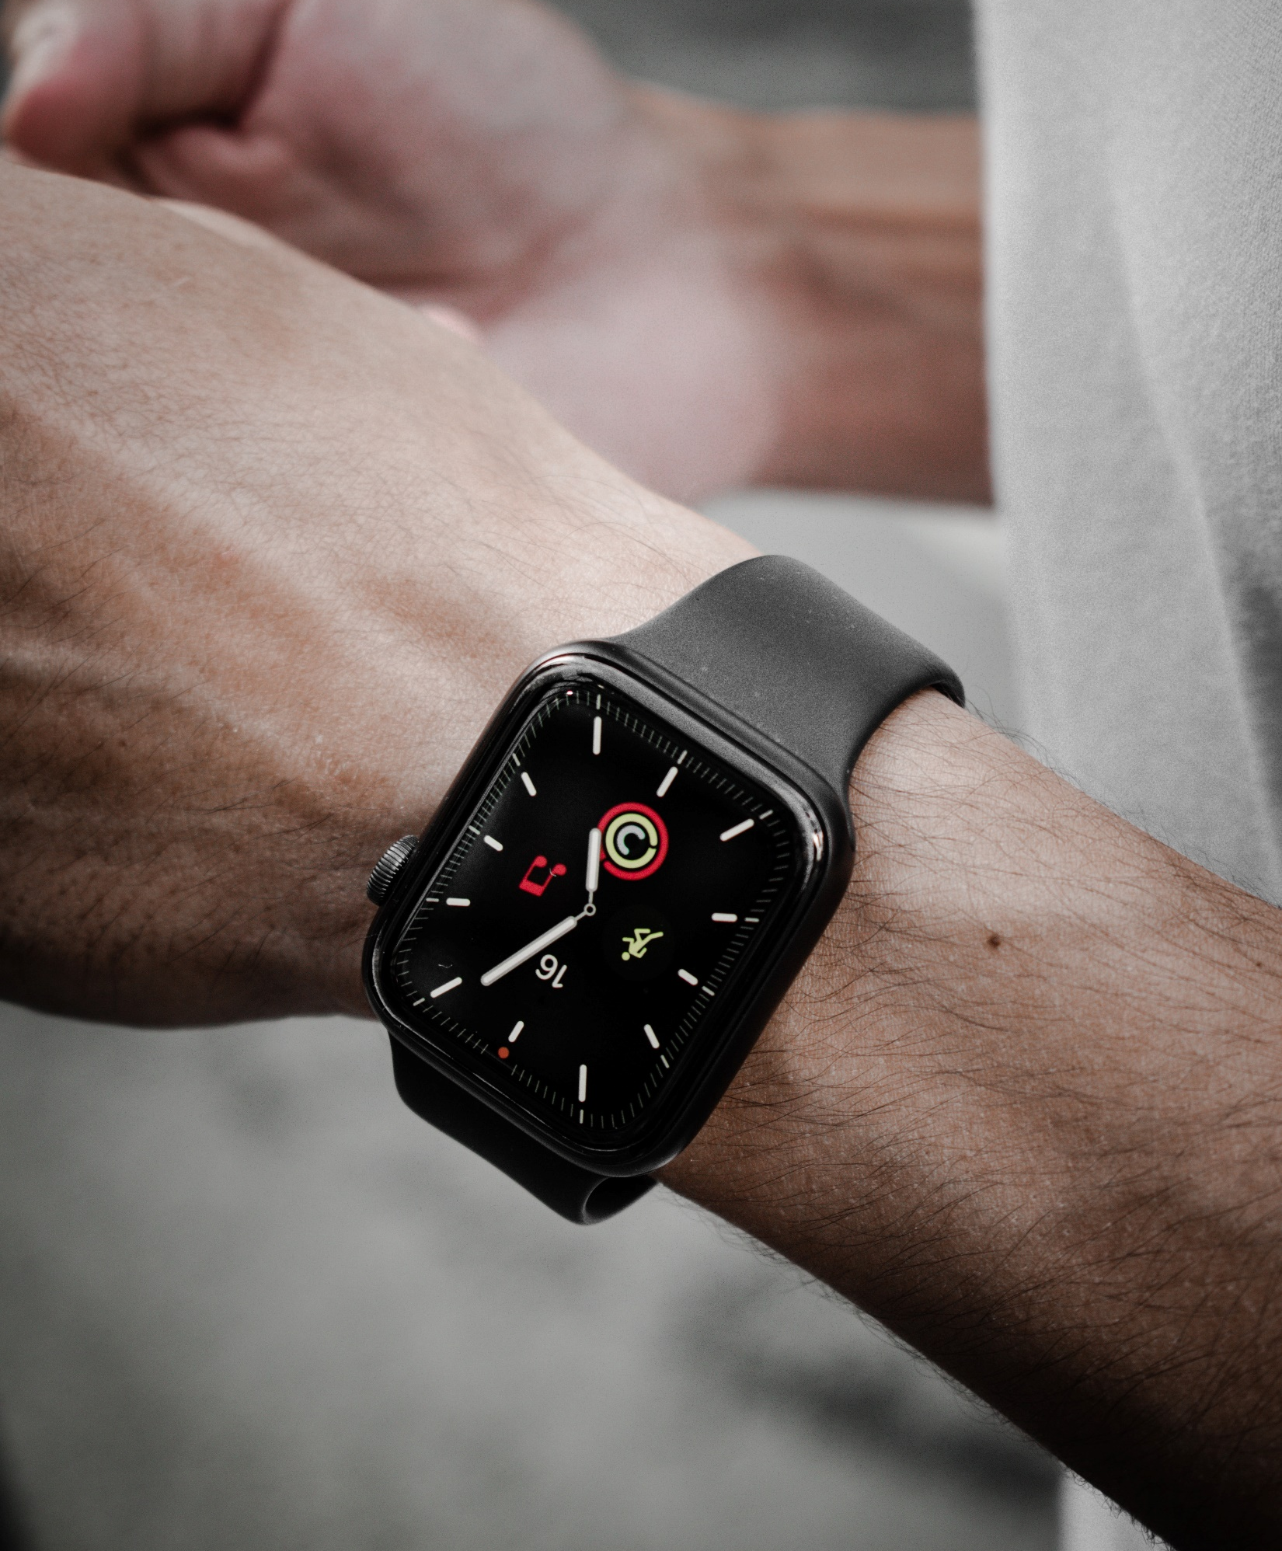
K.E.Y.S. Pro
Price : $ 1299
Features :
- 20 liters of storage
- Face recognition
- Holographic interface
- Longer battery life (48 hours)
- Storage can be shared with another user
- Wireless charging
- 3 years warranty

Slide 8
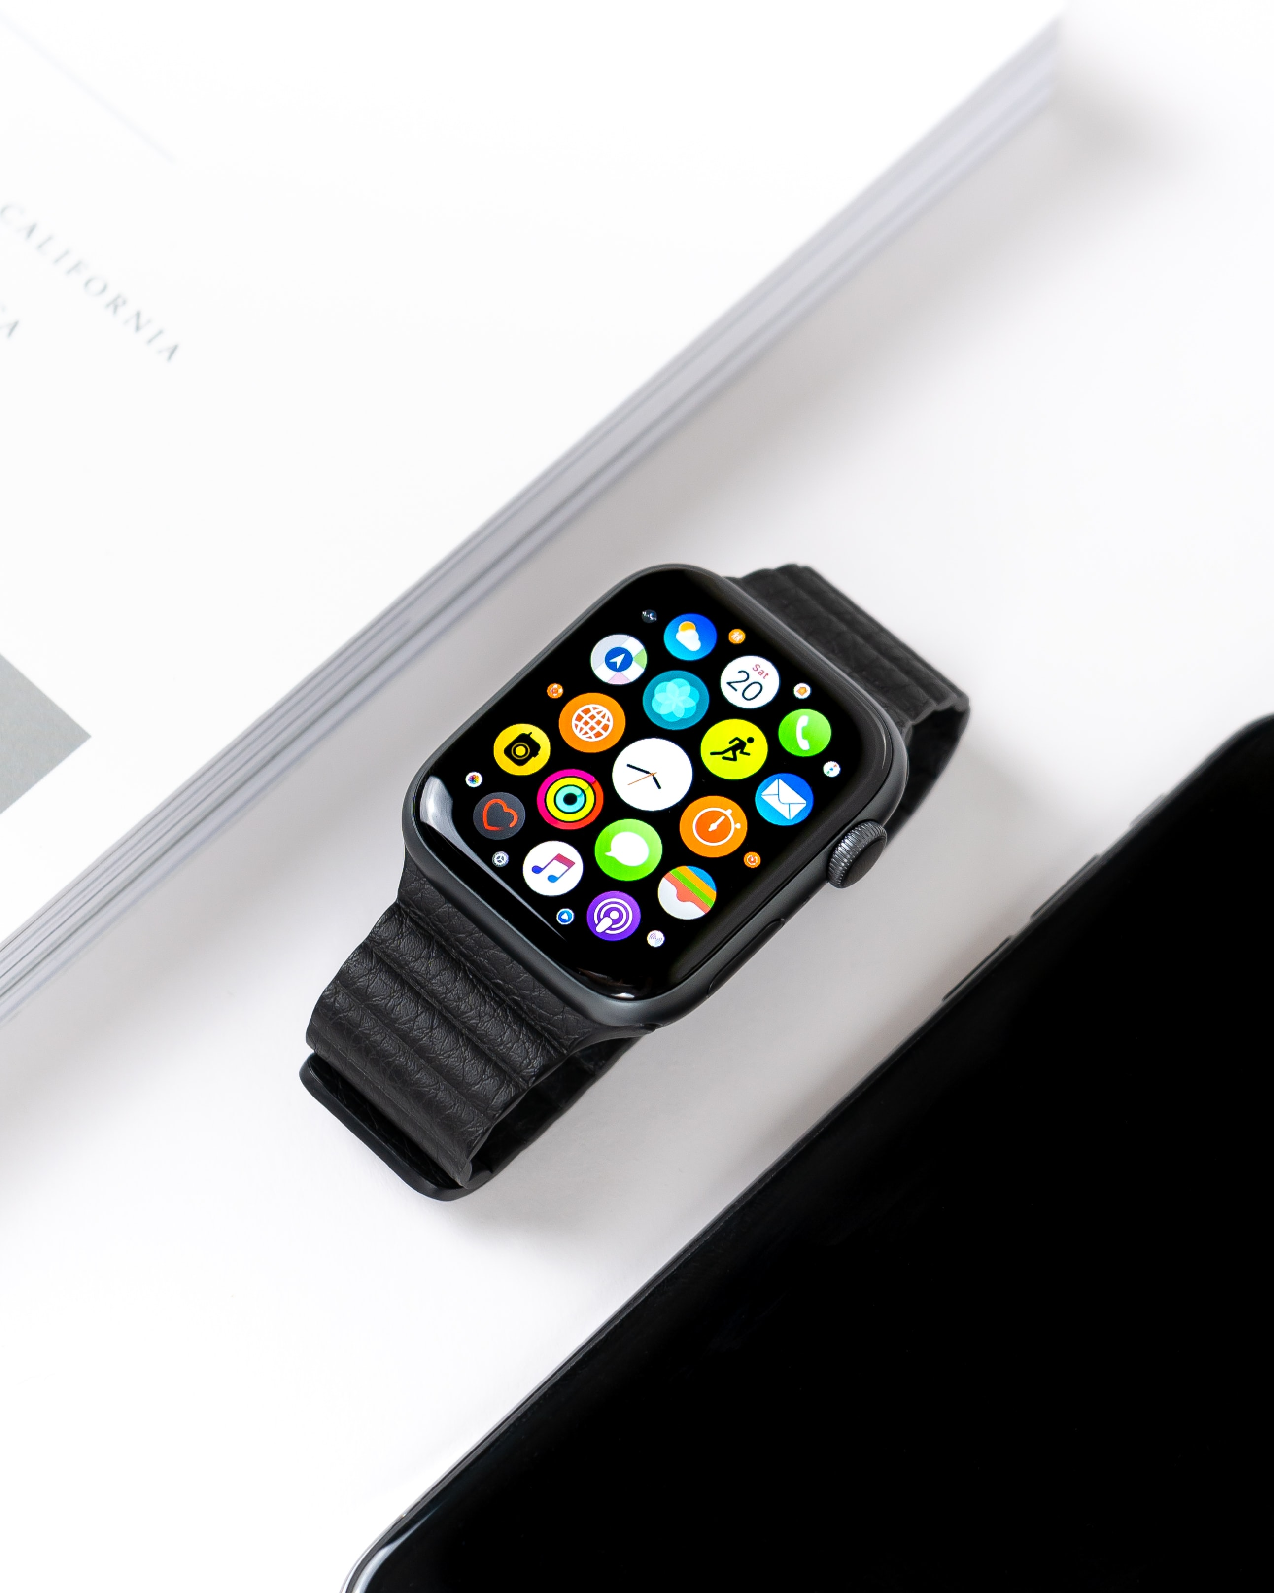
K.E.Y.S. Pro X
Price : $ 1999
Features :
- 35 liters of storage
- Face recognition and holographic interface
- Extra long battery life (168 hours)
- Storage can be shared with 7 users
- Wireless charging
- 4 years warranty

Slide 9
Holidays Edition
Pumpkin Spice
Santa’s Time
Cupid Arrow
Price : $ 999
Same device as the Upgraded Edition but with a spooky twist for Halloween !
Price : $ 999
Same device as the Upgraded Edition but
now with some Christmas Spirit !
Price : $ 999
Same device as the Upgraded Edition but with a special theme to celebrate the holiday of Love !

